Slide 1
Synchronization using Semaphores
Comp 346 – Fall 2019
Tutorial # 4

Slide 2
Topics
Synchronization in Details
Semaphores
Introducing Semaphore.java

Slide 3
Synchronization
What is it?
An act of communication between unrelated processes to sync their activities to achieve some goals and solve some common problems of multi-programming.

Slide 4
Introducing the Semaphore Class
NOTE: Operations Signal and Wait are guaranteed to be atomic!
class Semaphore
{
private int value;
public Semaphore(int value)
{
this.value = value;
}
public Semaphore()
{
this(0);
}
...

Slide 5
Introducing the Semaphore Class (Con’t)
...
public synchronized void Wait()
{
while(this.value <= 0)
{
try
{
wait();
}
catch(InterruptedException e)
{
System.out.println ("Semaphore::Wait()
…” + e.getMessage());
e.printStackTrace();
}
}
this.value--;
}
...

Slide 6
Introducing the Semaphore Class (con’t)
...
public synchronized void Signal()
{
++this.value;
notify();
}
}

Slide 7
public class Semaphore {
private int value;
public Semaphore(){value = 0;}
public Semaphore(int v){value = v;}
public synchronized void P( ){
while( value <= 0){
try{ wait( );
} catch(InterruptedException e){ }
}
value--;
}
public synchronized void V( ) {
++value;
notify( );
}
}

Slide 8
Semaphore Initial Values
The mutex is initialized to 1 to allow only one thread into the critical section at any time.

Slide 9
Semaphore flow

Slide 10
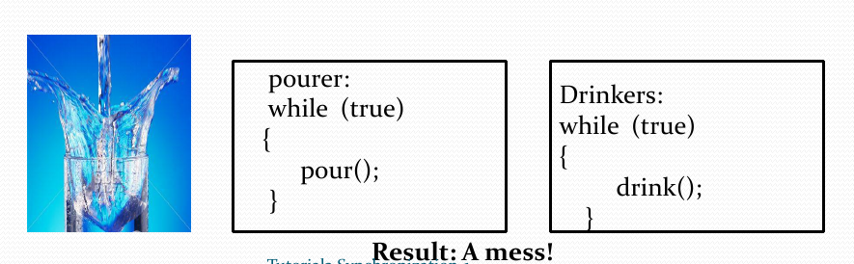
What's the Problem?
Example 1:
A cup of coffee
A “pourer” (producer)
A “drinker” (consumer)

Slide 11
A Typical Example
class John extends Thread {
run() {
balance = ATM.getBalance();
if(balance >= $200)
ATM.withdraw($200);
} }
class Jane extends Thread {
run() {
balance = ATM.getBalance();
if(balance >= $300)
ATM.withdraw($300);
} }
class ATM{ …
int withdraw(amount){
if(amount <= balance) {
balance = balance – amount;
return amount;
}
}
A trouble may occur at
the points marked with
the red arrows. The code
MUST NOT be interrupted
at those places.

Slide 12
Solution: Use Semaphores
Obvious: make the critical section part atomic.
One way of doing it: Semaphores
Semaphores are system-wide OS objects (also resources) used to
Protect critical section (mutexes – for Mutual Exclusion),
Coordinate other process’ activities.

Slide 13
Semaphores for CS
There are two main operations on semaphores – Wait() and Signal().
A process wishing to enter the critical section tries to acquire the semaphore (a lock in a human world) by calling Wait(sem),P().
If the lock isn’t there (i.e. “in use”), the execution of the process calling Wait() is suspended (put asleep).
Otherwise, it acquires the semaphore and does the critical section stuff.

Slide 14
Semaphores for CS
When a process is over with the critical section, it notifies the rest of the processes waiting on the same semaphore that they can go in by calling Signal(sem),V().
The process goes back to the ready queue to compete again to enter the critical section.

Slide 15
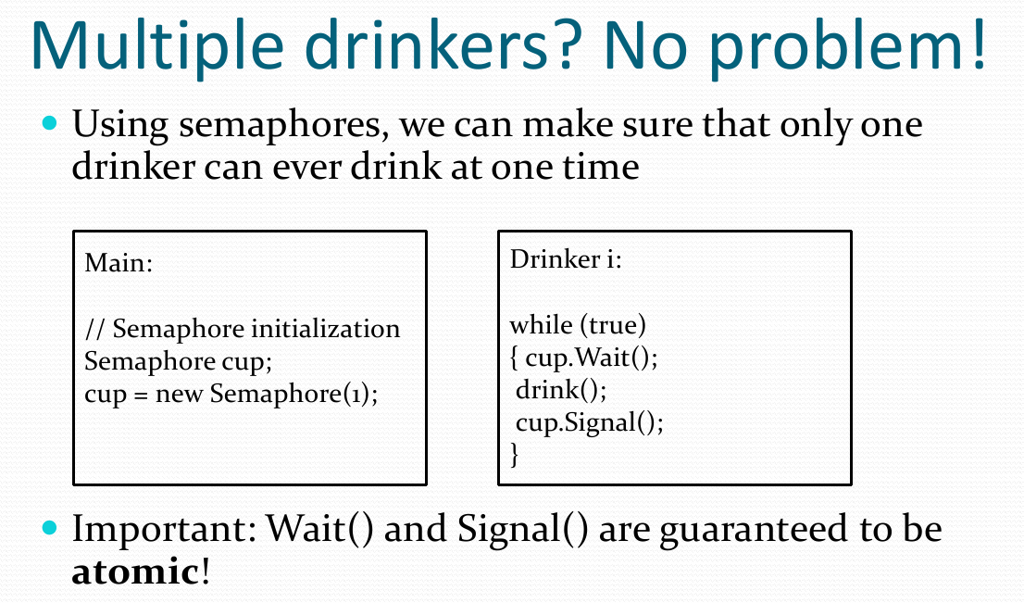

Slide 16
A Typical Example Solution
class John extends Thread {
run() {
mutex.Wait();
balance = ATM.getBalance();
if(balance >= $200)
ATM.withdraw($200);
mutex.Signal();
} }
class Jane extends Thread {
run() {
mutex.Wait();
balance = ATM.getBalance();
if(balance >= $300)
ATM.withdraw($300);
mutex.Signal();
} }
class ATM{ …
Semaphore mutex = 1;
int withdraw(amount) {
if(amount <= balance) {
balance = balance – amount;
return amount;
}
}

Slide 17
Semaphores for Barrier Sync
Take a look at the typical problem:
all processes must finish their phase I before any of them starts phase II
processes must proceed to their phase II in a specific order, for example: 1, 2, 3…
This is called barrier synchronization.
semaphore s1 = 0, s2 = 0;
process P1 process P2
<phase I> <phase I>
V (s1) V (s2)
P (s2) P (s1)
<phase II> <phase II>

Slide 18
Barrier Sync for Three Processes
A possible copy-cat attempt:
Why it doesn’t work?
semaphore s1 = 0, s2 = 0, s3 = 0;
process P1 process P2 process P3
<phase I> <phase I> <phase I>
V (s1) V (s2) V (s3)
P (s3) P (s1) P (s2)
<phase II> <phase II> <phase II>

Slide 19
Barrier Sync for Three Processes
A possible copy-cat attempt:
Why it doesn’t work?
Scenario: 1-6 , process 2 even hasn’t started!
None of the requirements are met
semaphore s1 = 0, s2 = 0, s3 = 0;
process P1 process P2 process P3
3 <phase I> <phase I> 1 <phase I>
4 V (s1) V (s2) 2 V (s3)
5 P (s3) P (s1) P (s2)
6 <phase II> <phase II> <phase II>

Slide 20
Barrier Sync for Three Processes (2)
Another attempt:
What’s wrong now?
semaphore s1 = 0, s2 = 0, s3 = 0;
process P1 process P2 process P3
<phase I> <phase I> <phase I>
P (s1) V (s1) V (s1)
P (s1) P (s2) P (s3)
V (s2) V (s3)
<phase II> <phase II> <phase II>

Slide 21
Barrier Sync for Three Processes (2)
Another attempt:
What’s wrong now?
Scenario: 1-10, so far so good, but after…
The second requirement isn’t met
semaphore s1 = 0, s2 = 0, s3 = 0;
process P1 process P2 process P3
7 <phase I> 4 <phase I> 1 <phase I>
8 P (s1) 5 V (s1) 2 V (s1)
9 P (s1) 6 P (s2) 3 P (s3)
10 V (s2) V (s3)
<phase II> <phase II> <phase II>

Slide 22
Barrier Sync for Three Processes (3)
Last attempt:
A bit “optimized”:
semaphore s1 = 0, s2 = 0, s3 = 0;
process P1 process P2 process P3
<phase I> <phase I> <phase I>
P (s1) V (s1) V (s1)
P (s1) P (s2) P (s3)
<phase II> <phase II> <phase II>
V (s2) V (s3)
semaphore s1 = -1, s2 = 0, s3 = 0;
process P1 process P2 process P3
<phase I> <phase I> <phase I>
V (s1) V (s1)
P (s1) P (s2) P (s3)
<phase II> <phase II> <phase II>
V (s2) V (s3)

Slide 23
Barrier Sync: Need for the General Solution
Problem with the proposed solution: # of semaphores == # of processes.
Semaphores as any other resource are limited and take space => overhead
Imagine you need to sync 10 processes in the same manner? 100? 1000?
Complete mess and a high possibility of a deadlock!

Slide 24
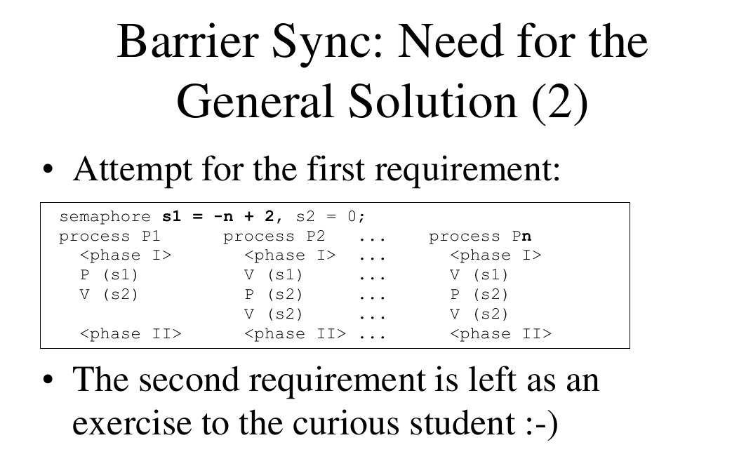

Slide 25
Counting vs Binary Semaphores
Counting Semaphores allow arbitrary resource count (semaphore values that can be <0 and >1)
Binary Semaphores only allow two values: 0 and 1
25

Slide 26
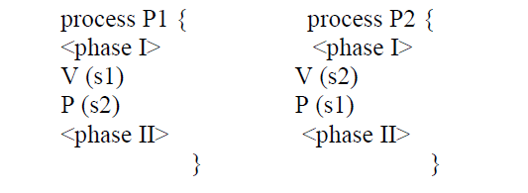
Q1
Sometimes it is necessary to synchronize two or more processes so that all processes must finish their first phase before any of them is allowed to start its second phase. This is called Barrier synchronization.
For two processes, we might write:
Give a solution to the problem for three processes P1, P2, and P3 using 3 semaphores.

Slide 27
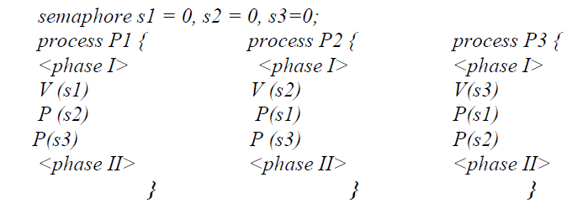
Possible S1
This solution still has a fatal error! Can you find it?
Hint: are phase II’s of all processes guaranteed to be executed?

Slide 28
Revised S1
semaphore s1 = 0, s2 = 0, s3 = 0
Process 1 Process 2 Process 3
<phase I> <phase I> <phase I>
V(s1) V(s2) V(s2)
P(s2) P(s1) P(s3)
P(s2) P(s1)
<phase II> <phase II> <phase II>
V(s1) V(s3)

Slide 29
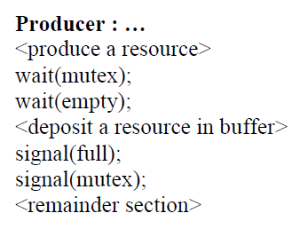
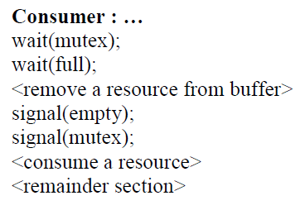
Q2
Consider the following solution to the producer and consumer problem. Does the solution respect the critical section requirements? Explain.

Slide 30
S2
Three critical sections,
one to access the buffer (synchronized by mutex),
one to access an empty buffer slot (synchronized by empty),
and one to access a full buffer slot (synchronized by full).
Progress requirement is violated because a process that is blocked on an empty or full semaphore will block the other process because it had previously locked the mutex semaphore.
For example, if the producer blocks on an empty semaphore it will prevent the consumer to access an available full buffer.
Consequently a deadlock situation (causing indefinite waiting) will occur because the producer and consumer processes will be both blocked waiting for an event that may be caused only by one of them.

Slide 31
References
[1]http://users.encs.concordia.ca/~mokhov/comp346/
[2]http://programmingexamples.wikidot.com/java-barrier
[3]http://docs.oracle.com/javase/tutorial/essential/concurrency/sync.html
[4]Sample question are from, Theory assignment 2, COMP 346, Operating Systems, Kerly Titus

